Slide 1
Java Plays : Watson Lab
IBM
ECOD

Slide 2
AGENDA
Purpose of This Lab
Pre-Requisites
Create a New Java Project
Add Dependency Jar
Run PersonalityInsights Java Snippet
Run All Watson Services Java Snippets
Java Plays : Watson Services

Slide 3
Purpose of This Lab
In this lab, you will learn how to use Watson Services to leverage Cognitive Computing and Social Media data in the Cloud.
Java Plays : Watson Services

Slide 4
Pre-Requisites
Install Eclipse Mars
Install Java JDK 1.7
Java Plays : Watson Services

Slide 5
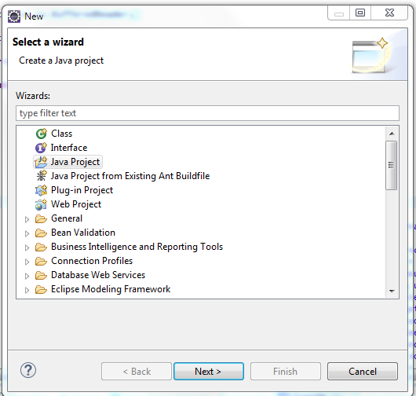
Step 1: Create a New Java Project
Open your local Eclipse pointing to your preferred workspace.
Click left upper top menu, File >> New >> Java Project.
Java Plays : Watson Services

Slide 6
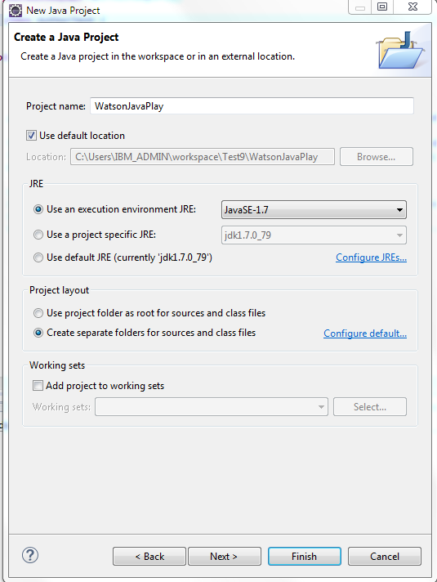
Click Next.
Name the project, WatsonJavaPlay.
Click Finish.
Java Plays : Watson Services

Slide 7

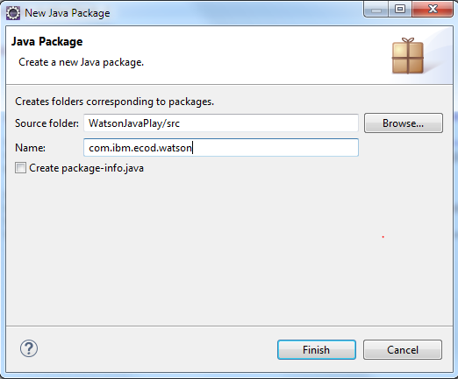
You have successfully created a Java project.
Right click on the project.
Select New >> Package.
Name the package as com.ibm.ecod.watson
Click Finish.
Java Plays : Watson Services

Slide 8
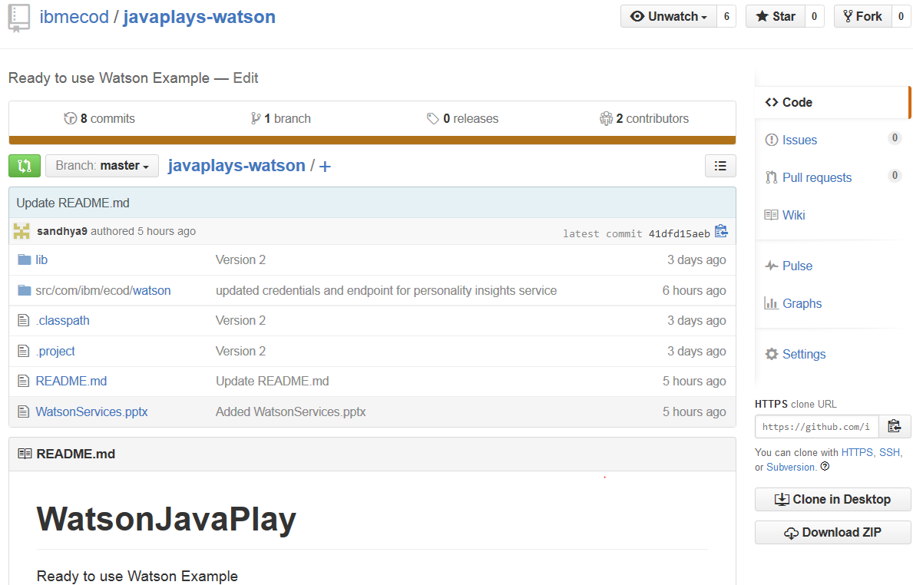
Step 2: Add Dependency Jar
Go to JavaPlays-Watson GitHub repository at https://github.com/ibmecod/javaplays-watson
Click Download Zip.
Java Plays : Watson Services

Slide 9
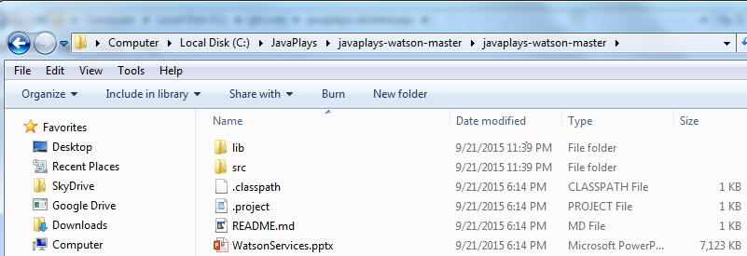
Unzip the downloaded file in your local folder.
Right click on your new Eclipse project >> Click Properties at the bottom.
Java Plays : Watson Services

Slide 10
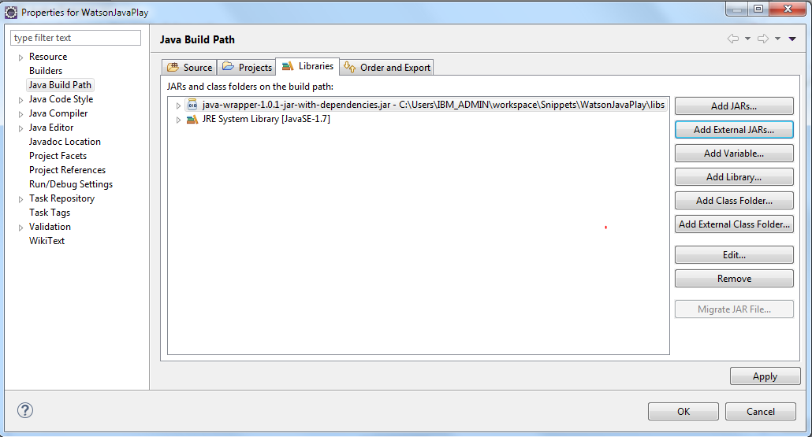
Select Java Build Path.
Click on Libraries tab >> Click Add External JARs.
Select java-wrapper-1.0.4-jar-with-dependencies.jar from your unzipped folder. e.g. \javaplays-watson-master\lib
Java Plays : Watson Services

Slide 11

Click OK.
Now, you are ready to add code using Watson Services.
Java Plays : Watson Services

Slide 12
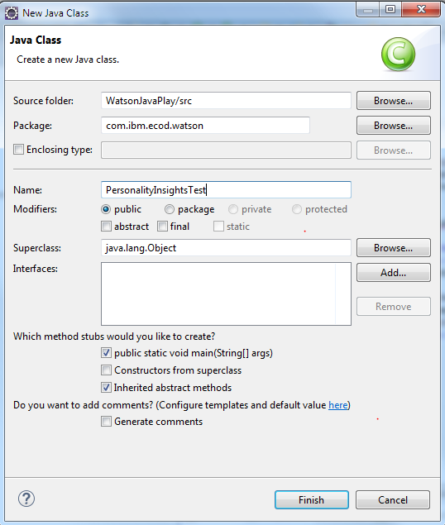
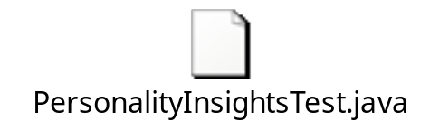
Step 3: Run PersonalityInsights Java Snippet
Create a new class in com.ibm.ecod.watson package you created in the new Eclipse project, WatsonJavaPlay.
Double click the following Java file to copy and paste the code in your class
Right click on the class.
Select Run As >> Java Application.
You will see the following result.
Java Plays : Watson Services

Slide 13
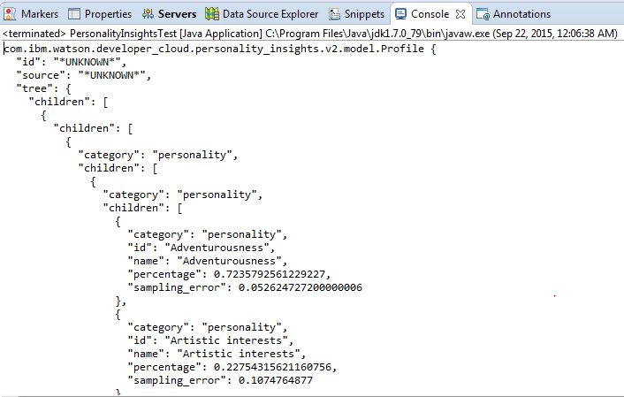
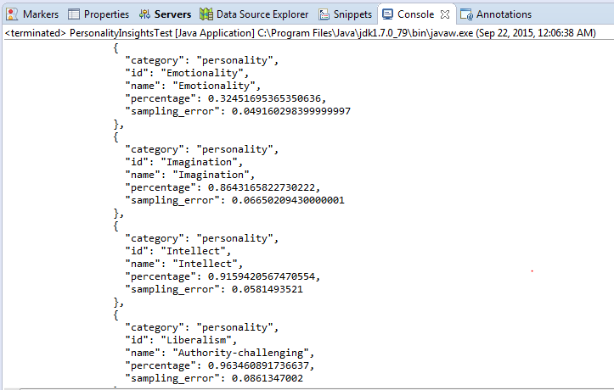
Replace lines 34 through 59 with a paragraph of your choice and run the PersonalityInsights snippet again.
Java Plays : Watson Services

Slide 14
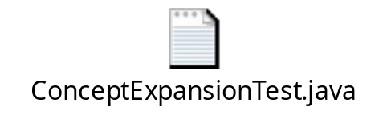

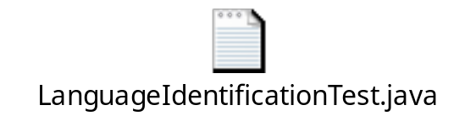

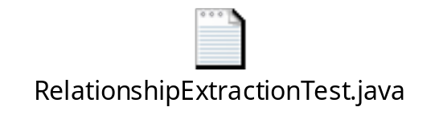
Step 4: Run All Watson Services Java Snippets
Repeat the same steps defined in step 3 to run each of the following Java Classes.
Java Plays : Watson Services

Slide 15
This ends the Watson Java Play Lab.
Thank you !
Java Plays : Watson Services

